Slide 1
High Performers Are More Agile
46x
440x
more frequent deployments
faster lead times than their peers
Source: Puppet/DORA: 2017 State Of DevOps Report: https://puppet.com/resources/whitepaper/state-of-devops-report

Slide 2
High Performers Are More Reliable
5x
96x
lower change failure rate
faster mean time to recover (MTTR)
Source: Puppet/DORA: 2017 State Of DevOps Report: https://puppet.com/resources/whitepaper/state-of-devops-report

Slide 3
High Performers Do Cool Stuff
21%
44%
less time spent on unplanned work and rework
more time spent on new work
Source: Puppet/DORA: 2017 State Of DevOps Report: https://puppet.com/resources/whitepaper/state-of-devops-report

Slide 4
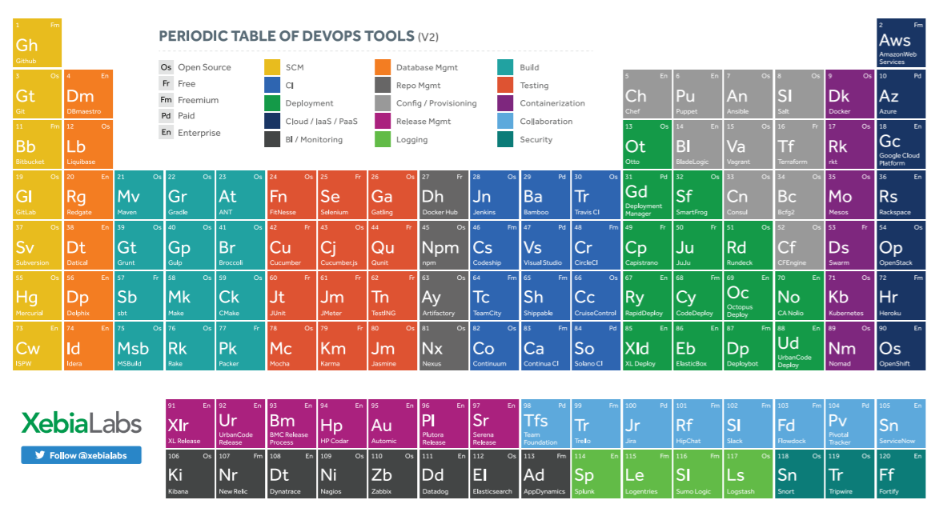
So Many Tools!
Notes:
What is minimum tool set needed in DevOps?

Slide 5
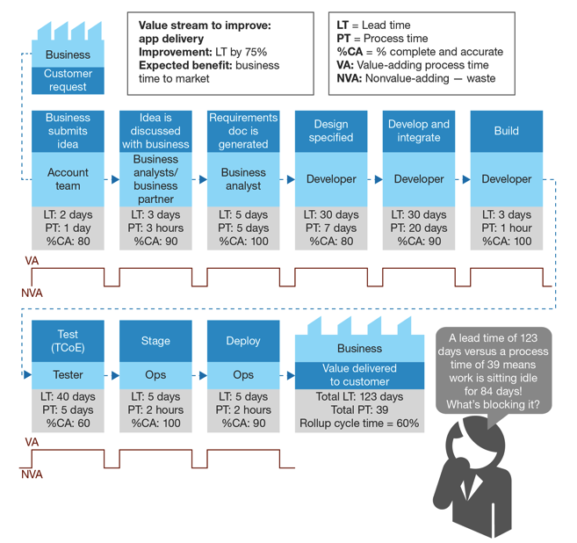
Organizational Challenges
Wait time Typically > Task Time
Root Causes
Role Silos
Sharing Resources Across Projects
Lack of a “Product Team” model

Slide 6
Scaling Challenges
Departmental Success != Enterprise-wide Success
Compliance
Visibility
Maintainability
Repeatability
Technical and Non-technical Participants

Slide 7



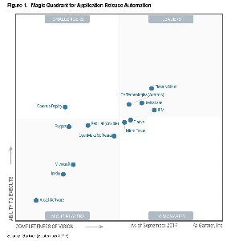

Enterprise DevOps Platform intelligence, automation and control
Learn more: www.youtube.com/xebialabs
Hundreds of Companies deliver software with XebiaLabs - faster, safer and more customer focused
Top-ranked
Continuous Delivery and DevOps pioneer, authority and technology leader
Global team in the US, Europe & APAC

Slide 8
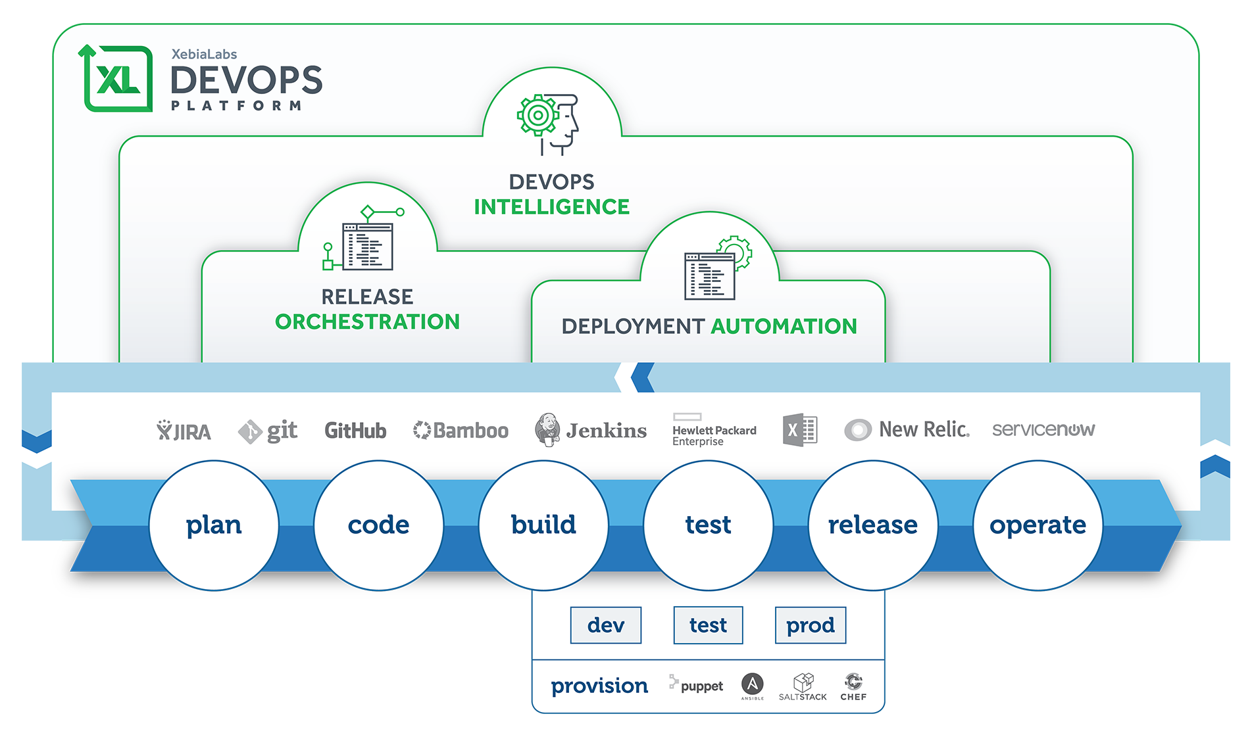
XebiaLabs Platform

Slide 9
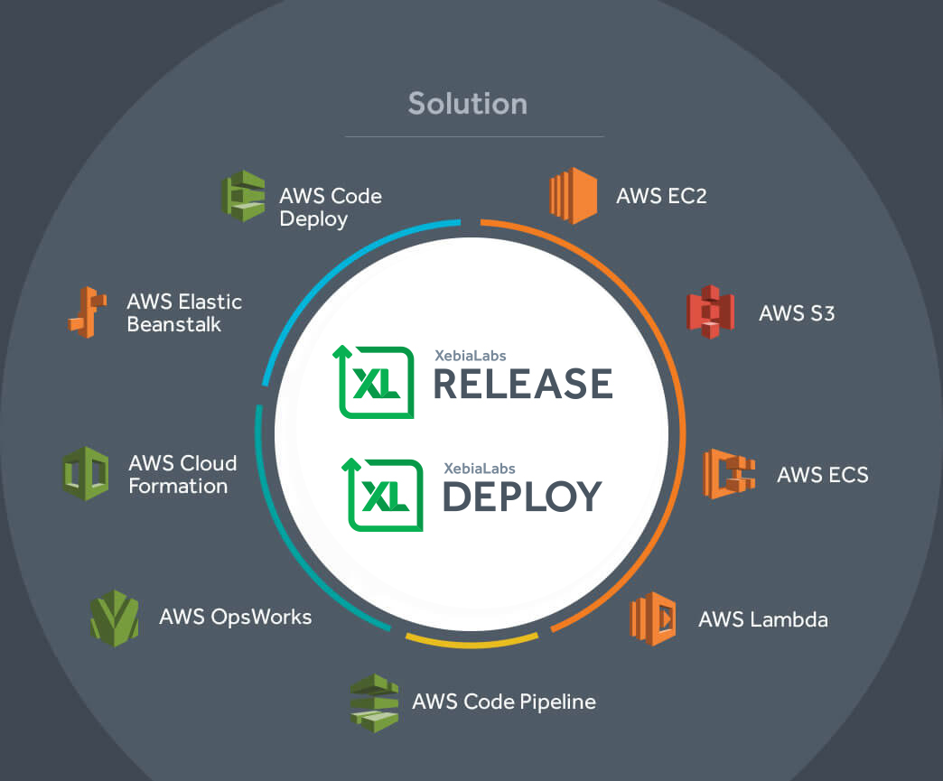
AWS DevOps Competency Partner

Slide 10
Amazon Web Services Actions from XebiaLabs Platform
Launch / terminate AWS Elastic Compute Cloud (EC2) and Virtual Private Cloud (VPC) instances
Deploy application to AWS cloud-based instances
Use Amazon’s Elastic Load Balancing feature for EC2 instances
Create and use Simple Storage Service (S3) buckets for file storage
Provision EC2 Container Service (ECS) clusters, tasks, and services
Use the Relational Database Service (RDS) for databases
Use the Elastic Block Store (EBS) for persistent block storage
Provision EC2 instances and deploy applications to them
Deploy network configurations such as VPC instances, subnets, routing tables, and network interfaces
Deploy load balancing configurations to AWS Elastic Load Balancing (ELB)
Deploy storage configurations such as EBS volumes and S3 buckets for file storage
Deploy content to S3 buckets
Deploy tasks and services to ECS clusters
Provision and work with EC2 Container Registry (ECR) repositories
Provision and work with Relational Database Service (RDS) instances
Deploy AWS Lambda functions
Provision AWS API Gateway to invoke Lambda functions

